Slide 1
JavaScript Essentials
Strings

Slide 2
Table of Contents
Overview
Strings basics
Template strings

Slide 3

Lesson Objectives
Understand the power of text in JavaScript and Front-end Development
Able to create/concatenate strings
Understand the difference of strings and numbers
Able to use template strings concatenate strings

Slide 4
Overview
Section 1

Slide 5
Overview – Power of text
Notes:
Words are very important to humans — they are a large part of how we communicate.
Since the Web is a largely text-based medium designed to allow humans to communicate and share information, it is useful for us to have control over the words that appear on it. HTML provides structure and meaning to our text, CSS allows us to precisely style it, and JavaScript contains a number of features for manipulating strings, creating custom welcome messages and prompts, showing the right text labels when needed, sorting terms into the desired order, and much more.
Pretty much all of the programs we've shown you so far in the course have involved some string manipulation.

Slide 6
Overview – Summary
Pretty much all of the programs we've shown you so far in the course have involved some string manipulation.
Understand strings give us a huge advantage in Programming
Notes:
Words are very important to humans — they are a large part of how we communicate. Since the Web is a largely text-based medium designed to allow humans to communicate and share information, it is useful for us to have control over the words that appear on it. HTML provides structure and meaning to our text, CSS allows us to precisely style it, and JavaScript contains a number of features for manipulating strings, creating custom welcome messages and prompts, showing the right text labels when needed, sorting terms into the desired order, and much more.
Pretty much all of the programs we've shown you so far in the course have involved some string manipulation.

Slide 7
Strings basics
Section 2

Slide 8
Strings basics – Create a string
Syntax (correct):
Notes:
Prefer: Single Quote

Slide 9
Strings basics – Create a string
Syntax (wrong):
Notes:
Prefer: Single Quote

Slide 10
Strings basics – Escaping characters
What if we have single quote or double quote in our string ? Like this: I’m studying
Use Escape notation syntax:
Notes:
This works fine. You can escape other characters in the same way, e.g. \", and there are some special codes besides. See Escape notation for more details.
Other character: \n, \t, \b

Slide 11
Strings basics – Escaping characters
Escape notation usage:
Notes:
This works fine. You can escape other characters in the same way, e.g. \", and there are some special codes besides. See Escape notation for more details.
Other character: \n, \t, \b

Slide 12
Strings basics – Concatenating strings

Slide 13
Strings basics – Concatenating strings
Joining together strings in JavaScript uses the plus (+) operator, the same one we use to add numbers together, but in this context it does something different

Slide 14
Strings basics – Concatenating strings
Result:

Slide 15
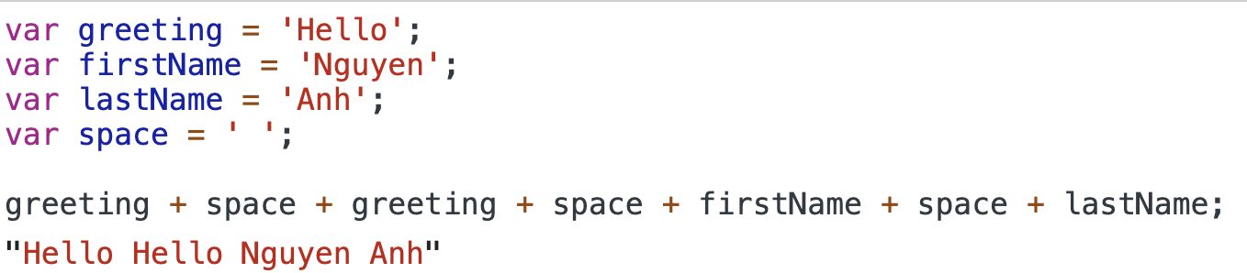
Strings basics – Concatenating strings
In the last instance, we joined only two strings, but you can join as many as you like, as long as you include a + between each pair. Try this:

Slide 16
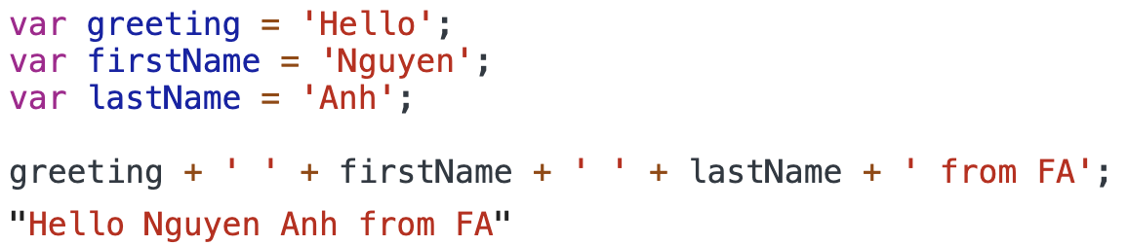
Strings basics – Concatenating strings
You can also use a mix of variables and actual strings. Try this:

Slide 17
Strings basics – Numbers and strings
So what happens when we try to add (or concatenate) a string and a number? Let's try it in our console:
Notes:
You might expect this to return an error, but it works just fine.
Trying to represent a string as a number doesn't really make sense, but representing a number as a string does, so the browser rather cleverly converts the number to a string and concatenates the two stringss

Slide 18
Strings basics – Numbers and strings
You can even do this with two numbers — you can force a number to become a string by wrapping it in quote marks. Try the following:

Slide 19
Strings basics – Numbers and strings
To convert between number and string:

Slide 20
Strings basics – Numbers and strings
Notes:
These constructs can be really useful in some situations. For example, if a user enters a number into a form's text field, it's a string. However, if you want to add this number to something, you'll need it to be a number, so you could pass it through Number() to handle this

Slide 21
Strings basics – Numbers and strings
Sometimes, it not work the way you wanted

Slide 22
Strings basics – Numbers and strings
To fix it:

Slide 23
Strings basics – Practice Time
Practice Strings manipulation
Notes:
P1:
Add 5 + ‘fresher’ + 6
P2: Add HTML string
Var name = ‘Fresher’
‘<h1>Hello ’ + name + ‘</h1>’;
P3: Complext HTML string
Var in = 10;
‘<input type=“text” value=“ + in + ’” placeholder=“Enter number” />’;

Slide 24
Strings basics - Summary
Create a string using single quote (‘), double quote (“)
When your string has single quote or double quote, escape it with \’, \”
Concatenating strings using + operators
You can concatenate strings and number with + operators
Take care when you concatenate strings and number it may give wrong answer

Slide 25
Template strings
Section 3
Notes:
Assignment operators

Slide 26
Template strings
Another type of string syntax that you may come across is template literals (sometimes referred to as template strings). This is a newer syntax that provides more flexible, easier to read strings.
Notes:
To turn a standard string literal into a template literal, you have to replace the quote marks (' ', or " ") with backtick characters (` `).

Slide 27
Template strings - Concatenation
Template literals simplify concatenating strings:

Slide 28
Template strings - Concatenation
Template literals work great with multiline:

Slide 29
Template strings - Concatenation
Template literals work great with numbers:

Slide 30
Strings basics – Practice Time
Practice Template Strings
Notes:
using template Strings redo Practice from Strings
P1:
Add 5 + ‘fresher’ + 6
P2: Add HTML string
Var name = ‘Fresher’
‘<h1>Hello ’ + name + ‘</h1>’;
P3: Complext HTML string
Var in = 10;
‘<input type=“text” value=“ + in + ’” placeholder=“Enter number” />’;

Slide 31
Assignment operators - Summary
Assignment operators provide useful shortcuts to keep our code cleaner and more efficient
Can use other variables on the right hand side of each expression as well
Notes:
let x = 3; // x contains the value 3
let y = 4; // y contains the value 4
x *= y; // x now contains the value 12

Slide 32

Thank you
Q&A

